Slide 1

Controlling the world
with Arduino & JavaScript_

Slide 2

var name = magnusGreen;
Travelling
Movies
Rock n’ Roll
Coffee
www
Consultant
JavaScript
TDD
.NET
Clean Code
Beer
Agile
Internet of things
New York
Master of Information Technology
Notes:
Magnus Green
Jobber i Microsoft-avdelingen

Slide 3
agenda_
The Internet of Things
My IoT project
Build a home automation system

Slide 4
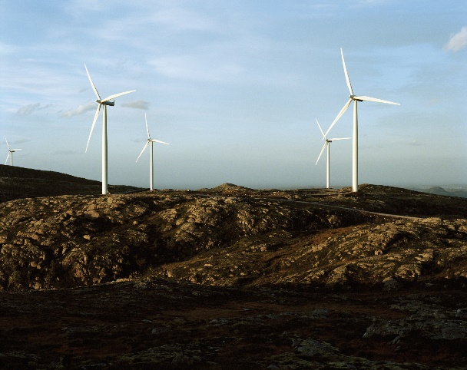
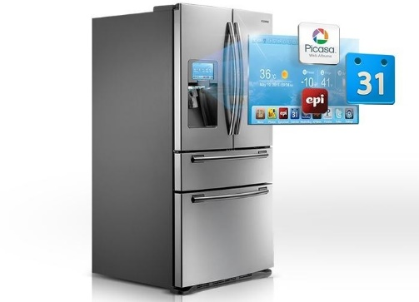
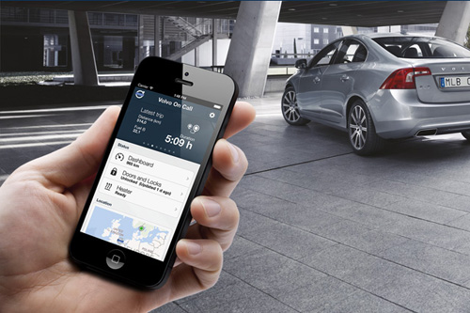
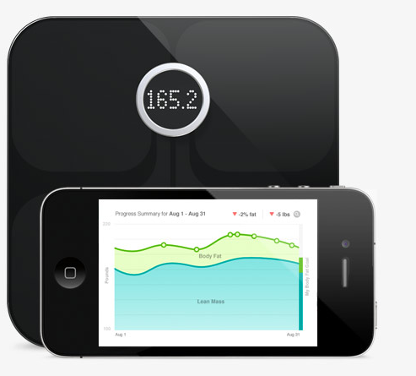
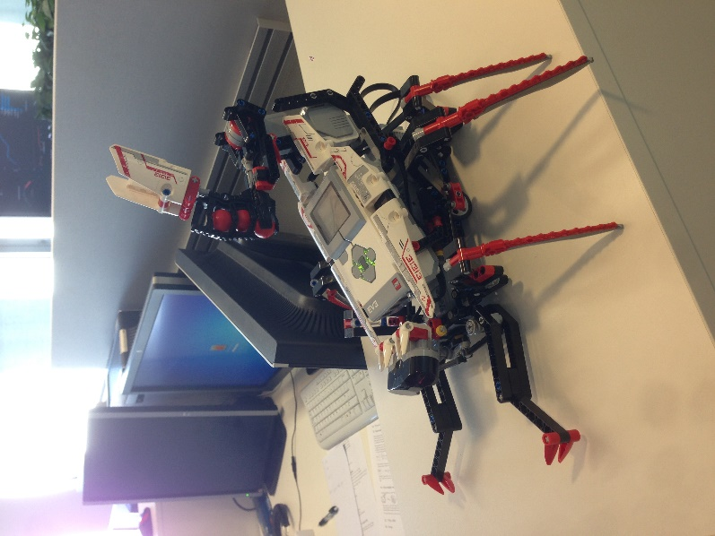
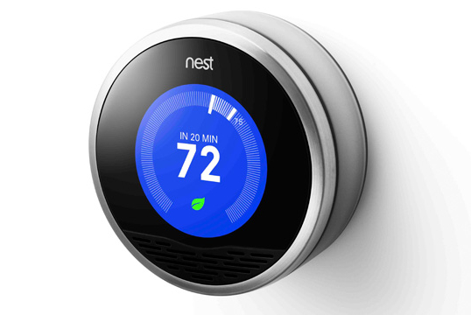
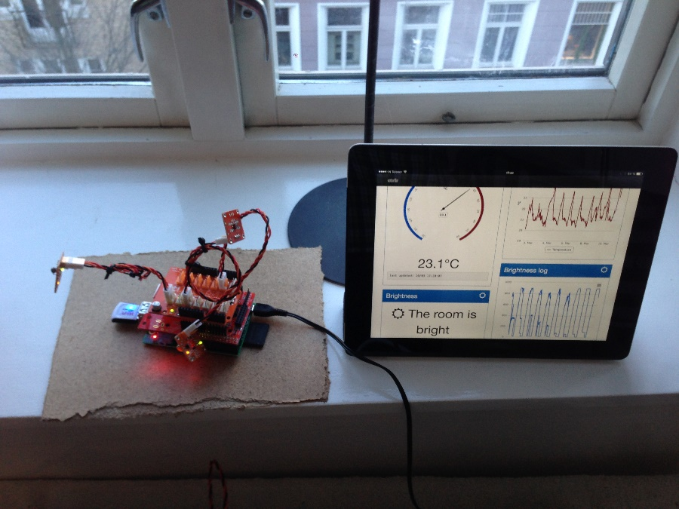
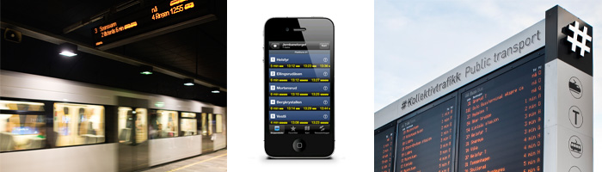
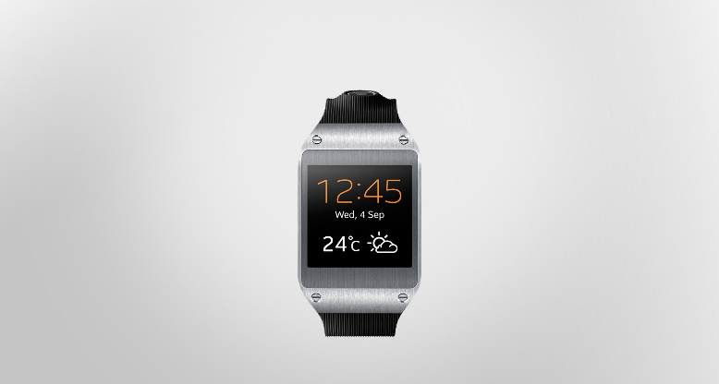

Slide 5
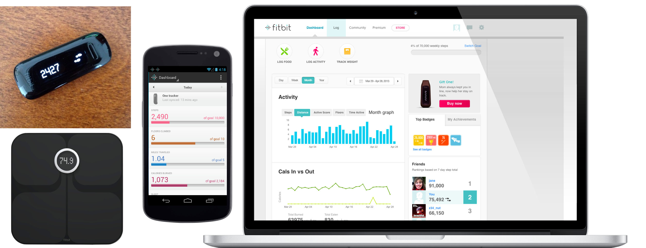
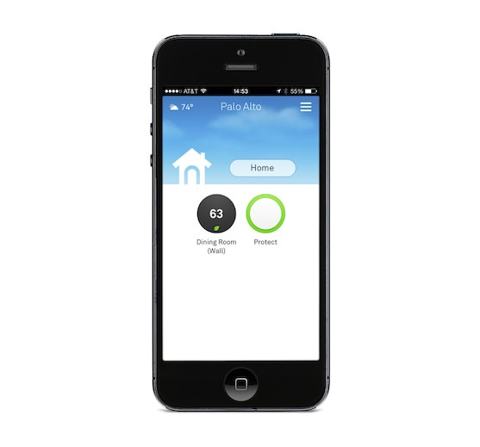
Notes:
Internet of Things

Slide 6
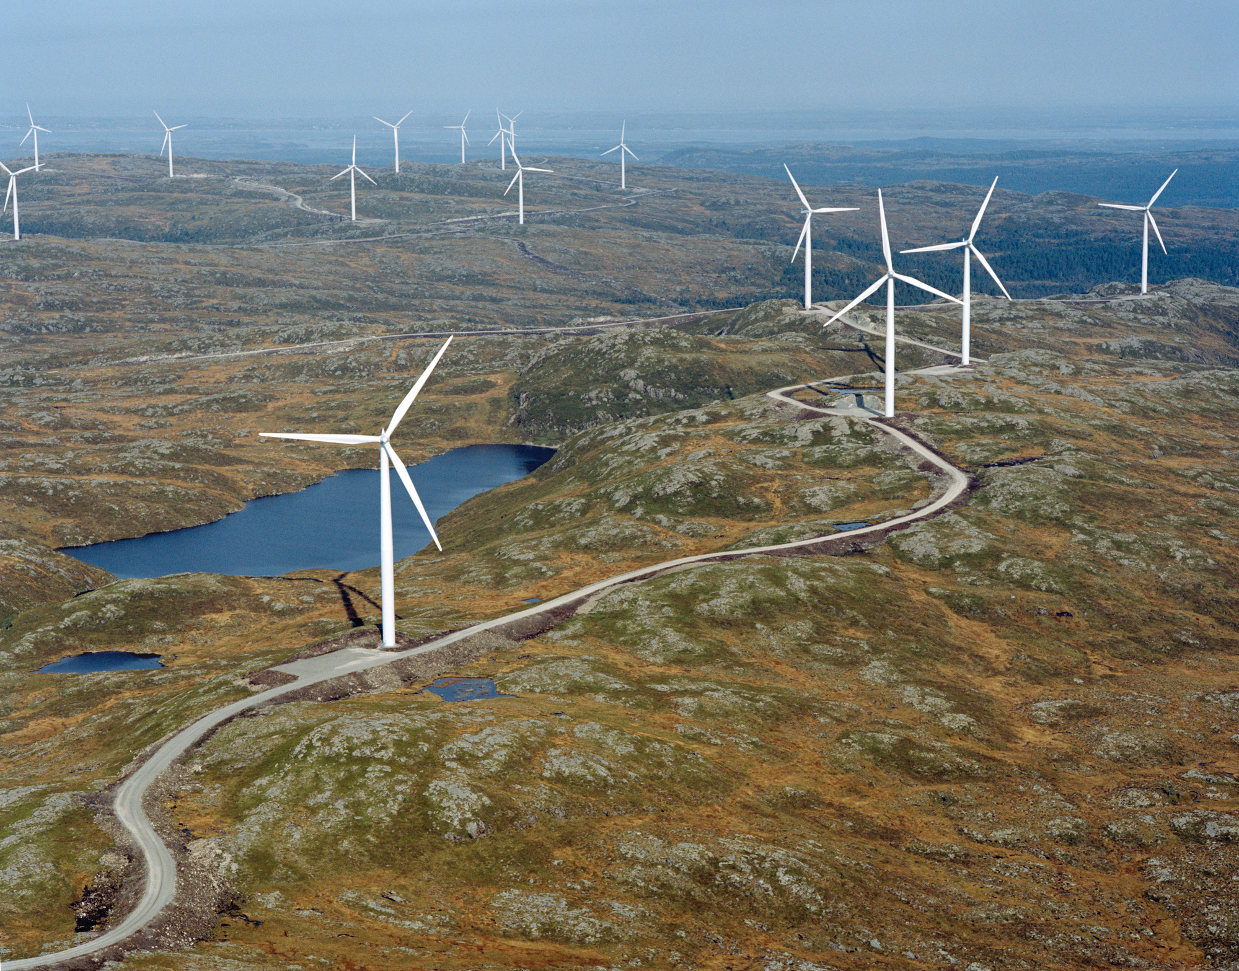
Notes:
Internet of Things

Slide 7

Notes:
Internet of Things

Slide 8
predictions_

Slide 9
my project_

Slide 11

arduino_
Can be connected to sensors and actuators
14 digital input / output pins and 6 analog input
Communication is done by sending or receiving 0V – 5V

Slide 12

johnny five_
Control Arduino with JavaScript
Using Firmata protocol to communicate with Arduino
Running in a node.js server
Convenient for web and cloud programming
Notes:
Introduce Johnny-five for controlling Arduino with JavaScript

Slide 13
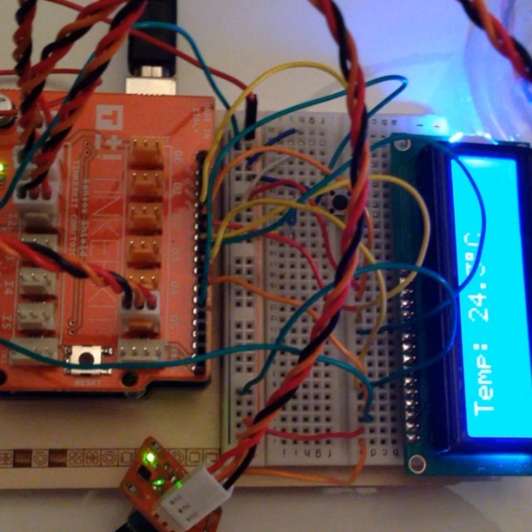
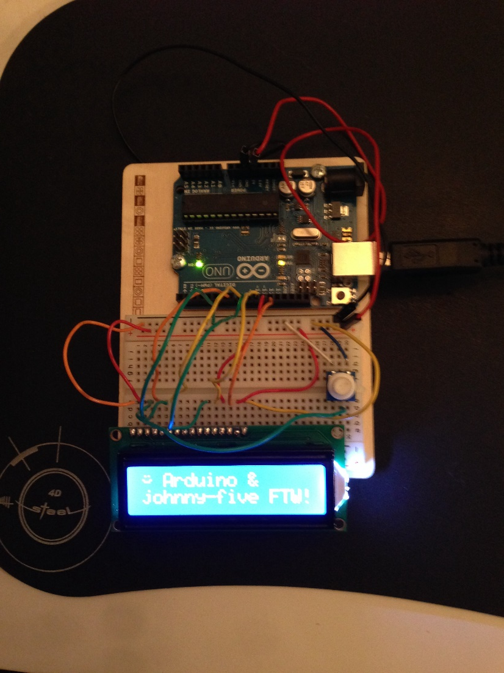
arduino hardware_
Notes:
Introduce Johnny-five for controlling Arduino with JavaScript

Slide 14
demo time_

Slide 15

want more?
Code available at github, https://github.com/magnushg/automatr
Contact me at magnus.green@bouvet.no or @magnusg
https://github.com/magnushg/automatr

Slide 16
